Slide 1





PID Motor
Controller
Group 13
EN2111 - Electronic Circuit Design

Slide 2


Introduction
In this project, we design an analog PID-based motor speed controller that maintains constant motor speed despite load variations.The system uses
A reference speed input
Feedback from motor encoder
Analog PID control
PWM-based motor drive

Slide 3
Block Diagram
1
2
3
FeedBack
Generation
PID Controller
Driver Stage
Integrator
Differentiator
Differential Amplifier
Summing Amplifier
PWM generator
(Relaxation Oscillator+
Integrator
Comparator)
Motor Driver
F-V converter

Slide 4
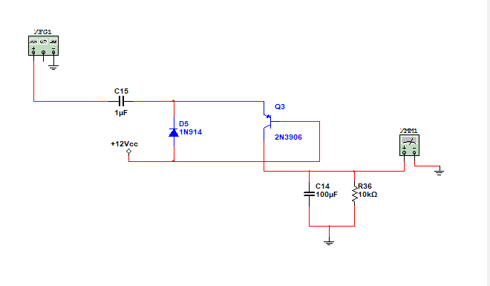
FeedBack Generation
F-V Conversion

Slide 5
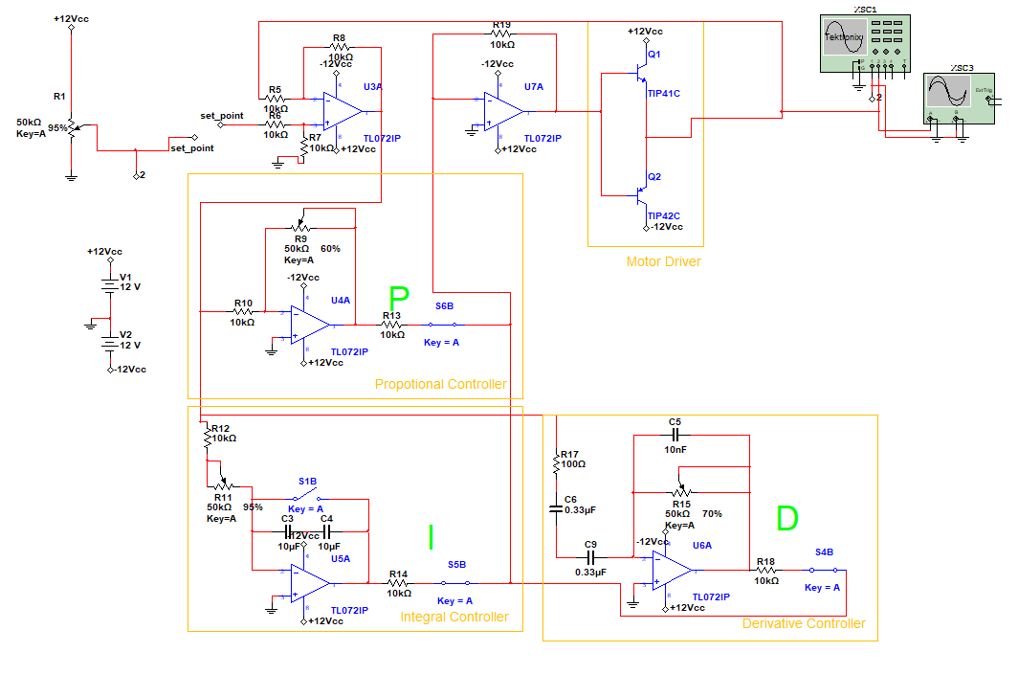
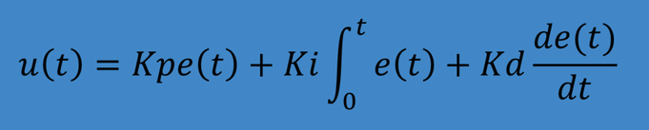
This is the core of the system.
Reduce error between desired and actual speed
Improve stability and response
Proportional (P): reacts to present error
Integral (I): removes steady-state error
Derivative (D): reduces overshoot and improves stability
Implemented using op-amp networks
PID Controller

Slide 6
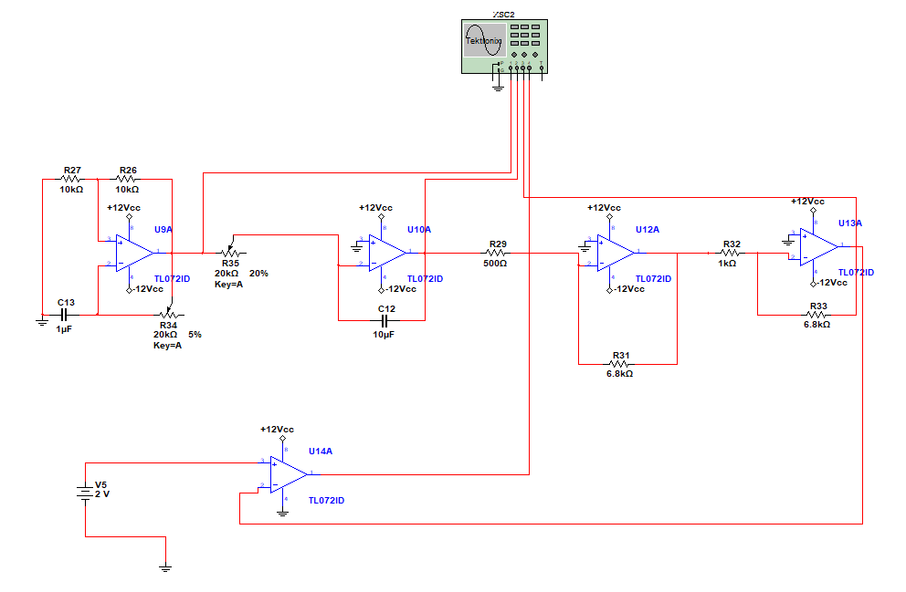
PWM Generation

Slide 7


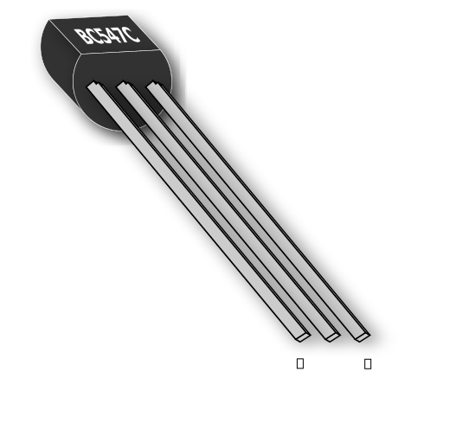



Op Amps-
TL071 - Has higher slew rate,low noise
LM741 -General purpose
Transistors-
2N3906P-switching/amplification
TIP41C- Motor Driver
DIodes-
1N914-Fast switching
Motor -
N20-built in magnetic encoder
Supply Voltage-
6V
±12V Dual Supply
Component
Selection
&
Specification

Slide 8

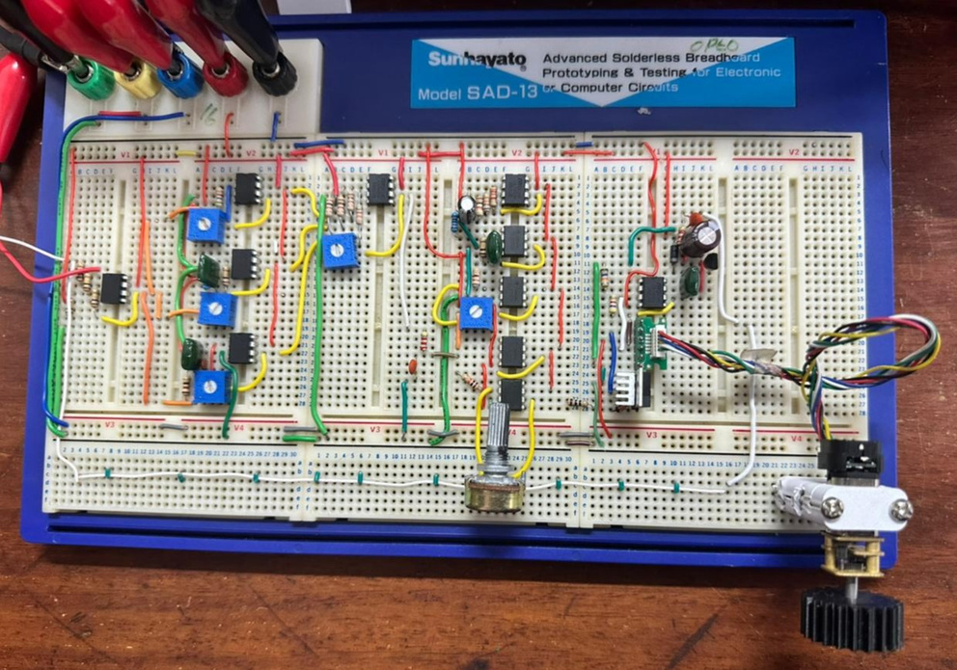
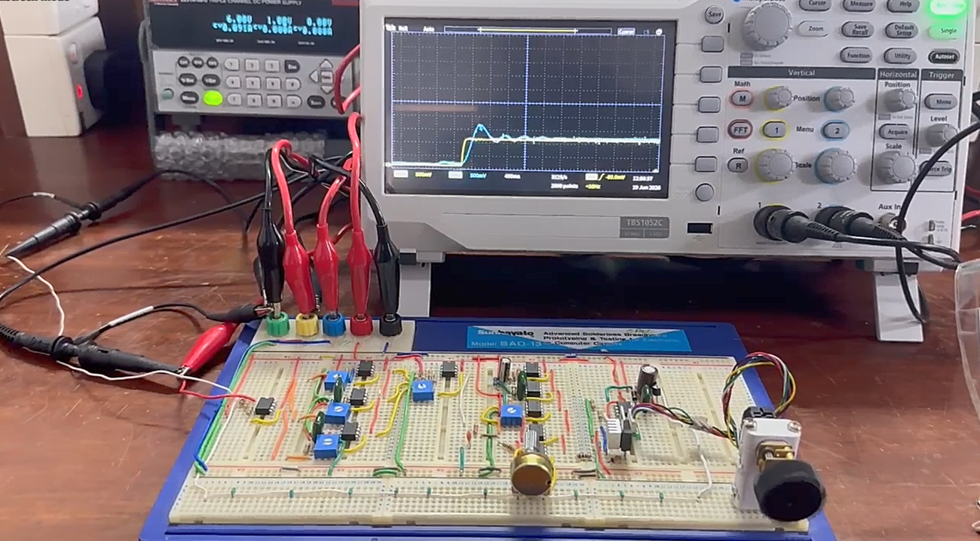

Bread Board Implementation

Slide 9





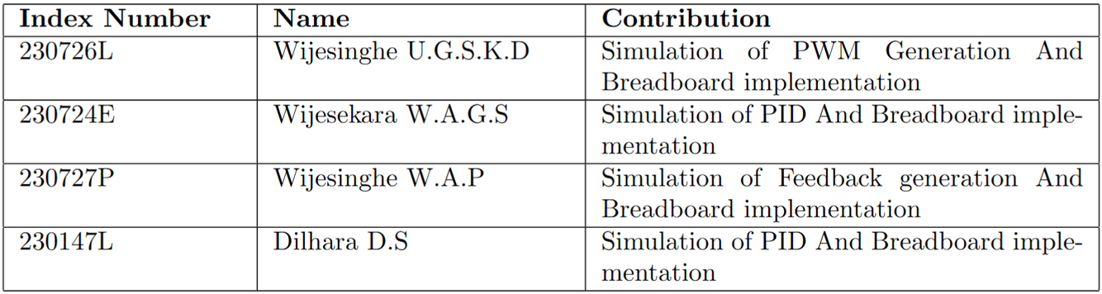



Thank You.

